Slide 1
Wi-Fi:
Starspace 46 guest
Password:
Techlahoma

Slide 2
FreeCodeCampOKC.com
facebook.com/groups/free.code.camp.oklahoma.city
linkedin.com/groups/12086660
meetup.com/FreeCodeCampOKC
twitter.com/FreeCodeCampOKC

Slide 3
Thanks for joining us today! We're here thanks to volunteers, speakers, and Techlahoma.

Slide 4
What is Techlahoma?
non-profit volunteer-run organization
hosts 33 groups and 2 conferences
sponsors free local events
supports the grassroots tech community of Oklahoma

Slide 5
Techlahoma.org
meetup.com/pro/Techlahoma
twitter.com/Techlahoma
donate.techlahoma.org/membership

Slide 6
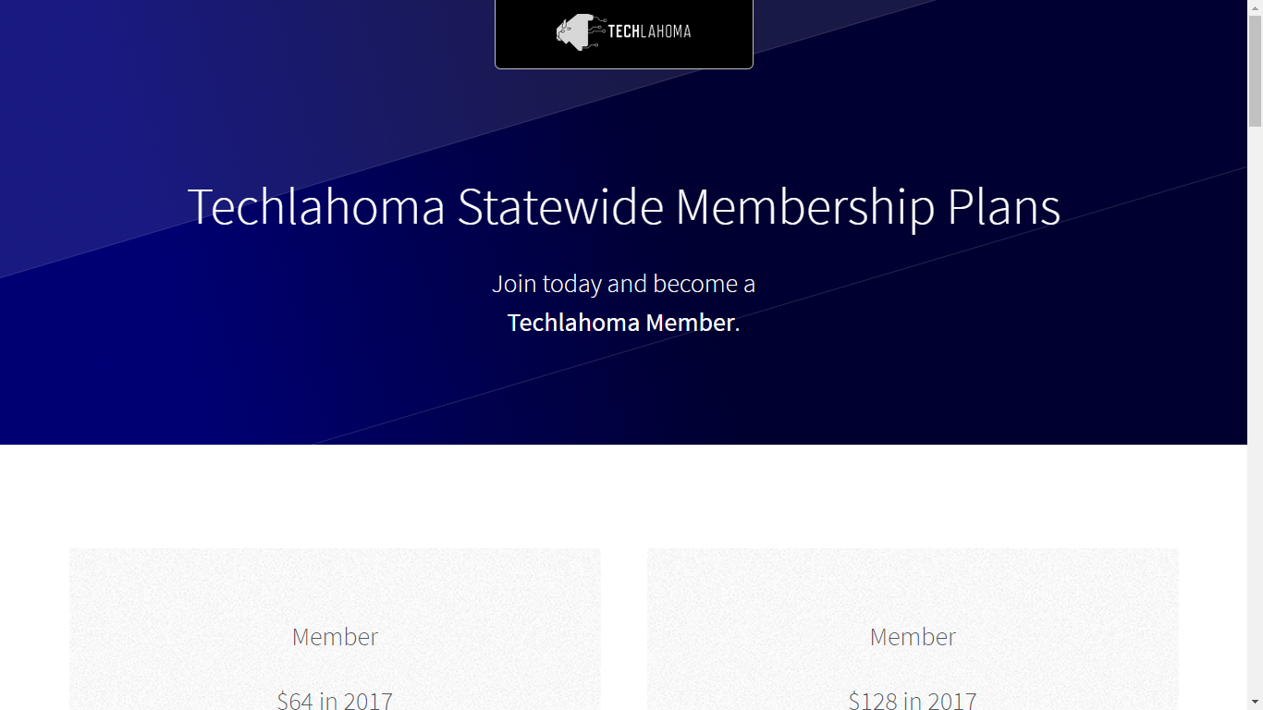
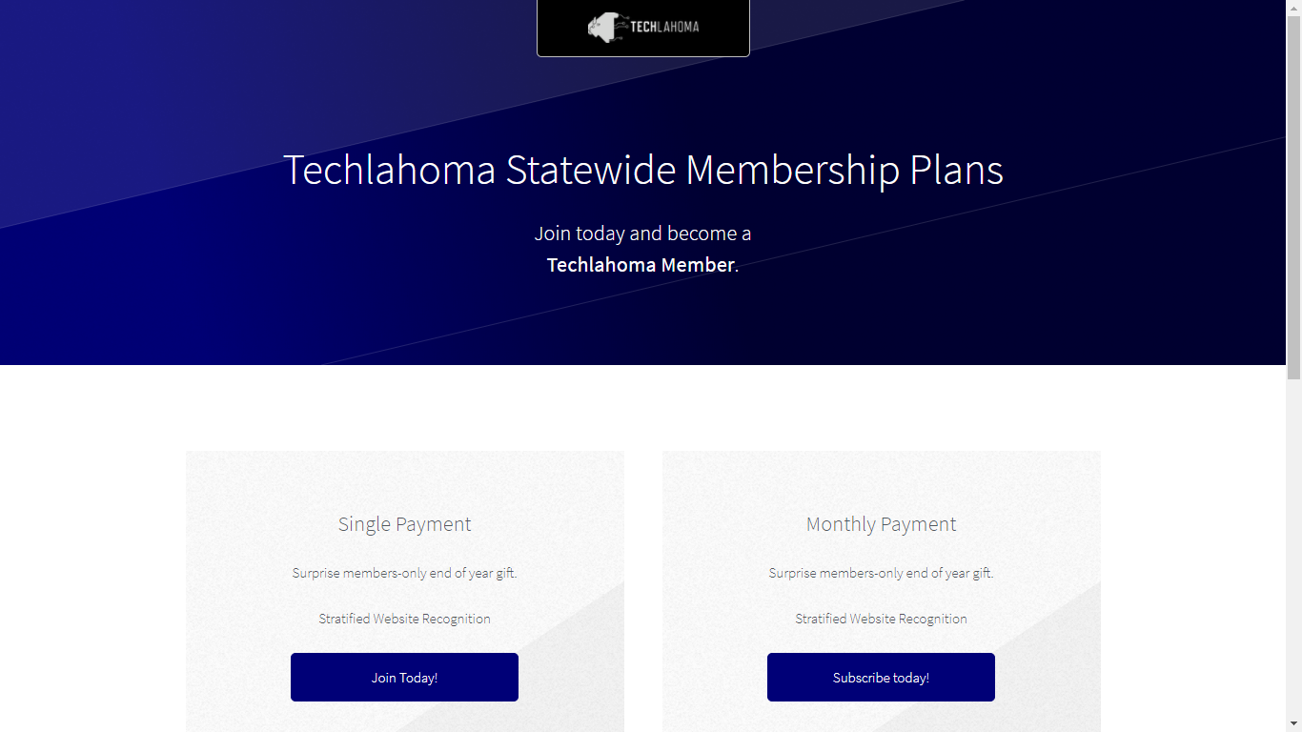

Slide 7
StarSpace46.com
starspace46.com/calendar-1
twitter.com/StarSpace46
Community membership $40/month

Slide 8
Twitch.tv/Techlahoma
Live streaming at StarSpace46
Subscribe with Amazon Prime
Techlahoma gets a small donation from Amazon

Slide 9
Slack
fccokc.com/slack
Channels for #freecodecamp, #jobs, #javascript, #design, and over 150 other topics

Slide 10
SheCodes OKC
Sunday 1/28
2:30 - 4:30 pm
Lightning Talks
meetup.com/shecodesokc

Slide 11
OKC FP
Tuesday 1/30
11:30 - 12:30
Servant: a Type-level DSL for Web API Specification
meetup.com/OKC-FP

Slide 12
Refresh OKC
Wednesday 1/31
11:30 - 12:30
Tommy’s Talks on UX
meetup.com/refresh-okc

Slide 13
OKC Big Data
Thursday 2/1
11:30 - 1:00
Data Pipelines
meetup.com/big-data-in-oklahoma-city

Slide 14
OK Game Developers
Thursday 2/1
7:00 - 8:00 pm
Lightning Talks
meetup.com/oklahoma-game-developers

Slide 15
Free Code Camp OKC
Sunday 2/4
2:00 - 3:00 pm
Intro to Angular with Maegan Womble
meetup.com/freecodecampokc

Slide 16
OKC#
Monday 2/5
11:30 - 12:30
Alexa SDK using Amazon and Azure
meetup.com/OKC-Sharp

Slide 17
OKC Coffee & Code
Next meetup will be scheduled soon!
Contact Kimberly Collins for details
meetup.com/okccoffeeandcode

